Slide 1
SOP of CET OPC UA Server & Client Configuration
May 12, 2021

Slide 2
CET OPC UA Server Capability
Realtime Data
Controls
Event & Alarm
Note:
  OPC UA Server and Discovery programs can be run in an independent folder, not rely on PecStar folders.
  OPC UA Server run on a Client Workstation pc, need to be able to connect to DServer successfully.

Slide 3
CET OPC UA Server Component
OPC UA Server Service: CET.Opcua.Server.Entry
Configuration Tool: CET.Opcua.Server.ConfigTool
.NetCore 3.1 SDK: dotnet-sdk-3.1.201-win-x86.zip
Note:
  CET.Opcua.Server.ConfigTool is used if required. When the data points in the system is less than 300,000, they all can be transferred by CET OPC UA Server, no need to select the parameters.

Slide 4
CET OPC UA Server Component
Discovery: CET.Opcua.Server.Discovery – discover CET OPC UA Server service and expose it to OPC UA Client
NSSM: nssm.zip – register CET.Opcua.Server and CET.Opcua.Server.Discovery as services
Commonly-used OPC UA Client: opc-expert.zip – third-party test tool to verify the CET OPC UA Server

Slide 5
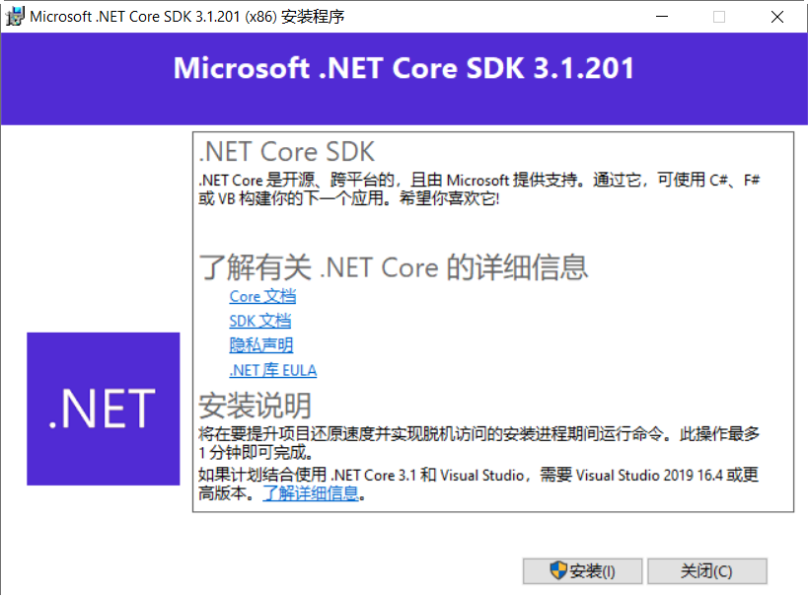
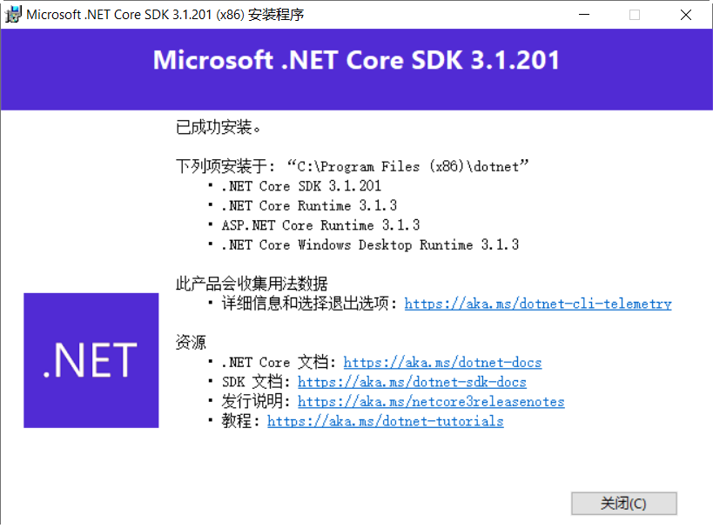
Install CET OPC UA Server
Step 1: double click dotnet-sdk-3.1.201-win-x86.exe to install.

Slide 6
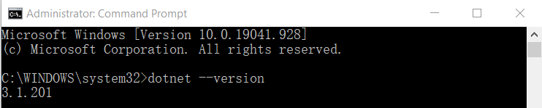
Install CET OPC UA Server
Step 2: Run CMD by administrator, input “dotnet --version” to double check the version of .netcore.

Slide 7
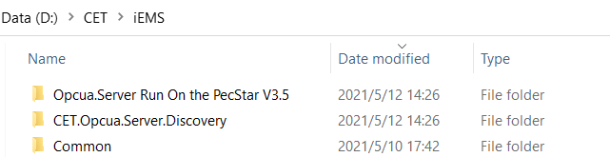
Install CET OPC UA Server
Step 3: Unzip Opcua.Server Run On the PecStar V3.5.zip, CET.Opcua.Server.Discovery.zip and put the unzipped folders in the same level of \Common folder.

Slide 8
Install CET OPC UA Server
Step 4: Copy the dbconn.cfg file under the \Common folder and replace the same name file under the \Opcua.Server Run On the PecStar V3.5 folder. Need to assign the DServer location in \Common\DatabaseConfig.exe and make sure the pc can connect to the database and download the system configuration successfully.

Slide 9
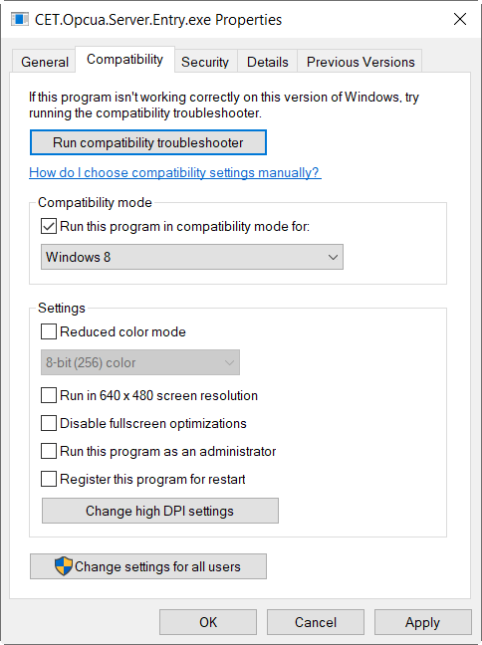
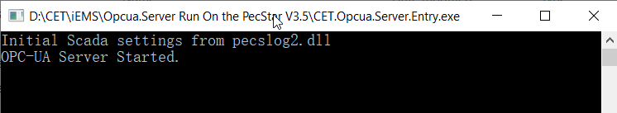
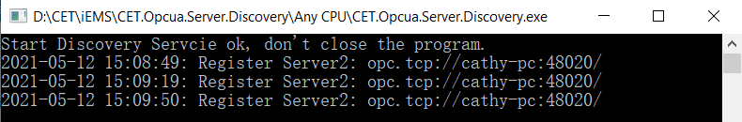
Install CET OPC UA Server
Step 5: Start DServer. Run \Opcua.Server Run On the PecStar V3.5\CET.Opcua.Server.Entry.exe and \CET\ CET.Opcua.Server.Discovery\Any CPU\CET.Opcua.Server.Discovery.exe by administrator. Make sure the two programs can work normally. Then close them.

Slide 10
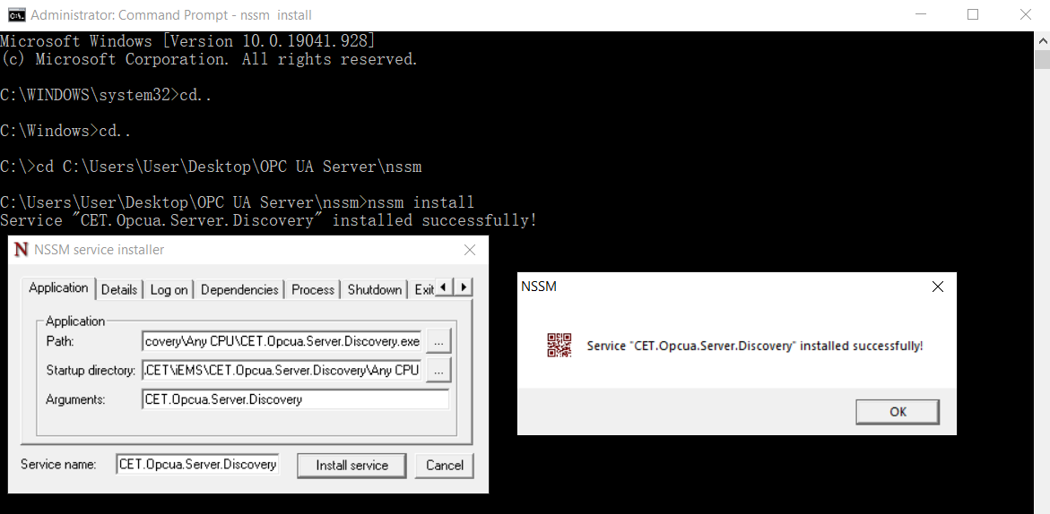
Install CET OPC UA Server
Step 6: Use nssm.exe to register the CET.Opcua.Server.Entry.exe and CET.Opcua.Server.Discovery to Windows Services. The services are to make CET UA Server to start and run automatically as Windows, no need to run by manually.
Run CMD by administrator, navigate to the directory of the nssm.exe, then input nssm install and press enter, the NSSM service installer window appears. Click the … browser button behind Application Path and select the directory of the CET.Opcua.Server.Discovery.exe, input CET.Opcua.Server.Discovery in Arguments and Service name and click Install service.

Slide 11
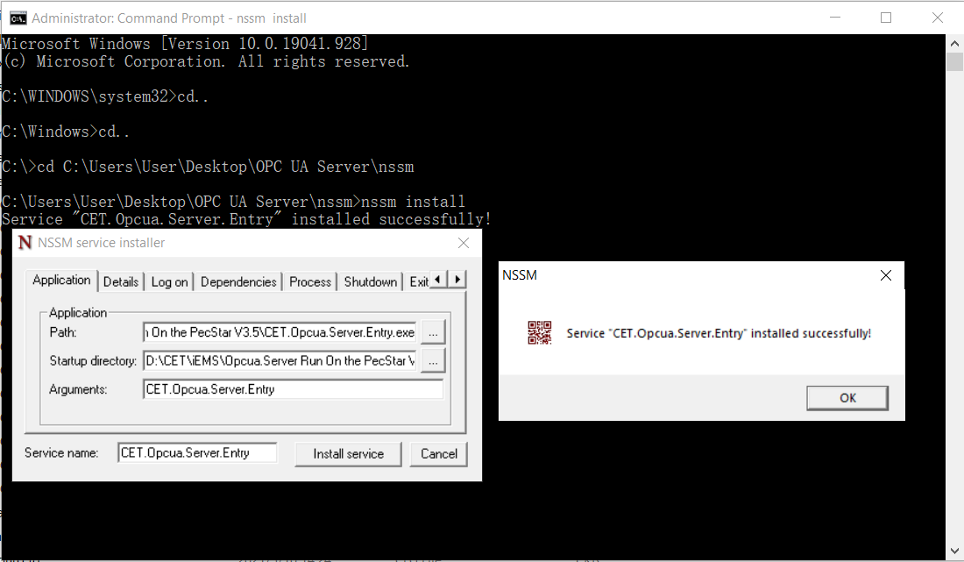
Install CET OPC UA Server
Run CMD by administrator, navigate to the directory of the nssm.exe, then input nssm install and press enter, the NSSM service installer window appears. Click the … browser button behind Application Path and select the directory of the CET.Opcua.Server.Entry.exe, input CET.Opcua.Server.Entry in Arguments and Service name and click Install service.

Slide 12
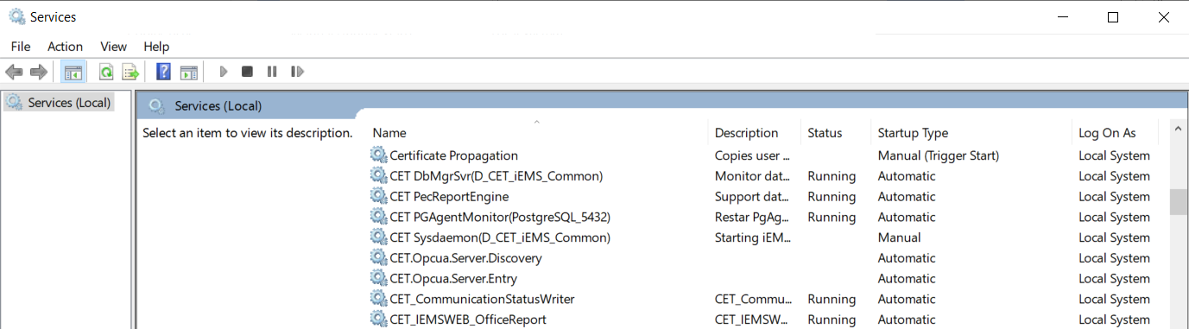
Install CET OPC UA Server
Open Windows Services to verify the CET.Opcua.Server.Discovery and CET.Opcua.Server.Entry services are installed successfully.

Slide 13
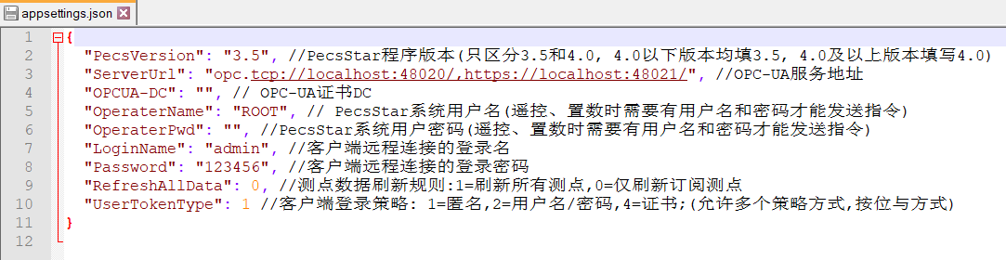
Install CET OPC UA Server
Step 7: Setting the user name and password of iEMS and security model in the \Opcua.Server Run On the PecStar V3.5\appsettings.json file if required. Uncheck the Read-only attribute before edit it.
UserTokenType: the authentication mode of CET OPC UA Server.
Value=1, anonymous (by default)
Value=2, user name and password
LoginName: user name of CET OPC UA Server
Password: password of CET OPC UA Server
Value=4, certificate and private key
OPCUA-DC: OPC UA cerficate DC
Note:
Need to restart CET.Opcua.Server.Discovery and CET.Opcua.Server.Entry services after the file is modified.

Slide 14
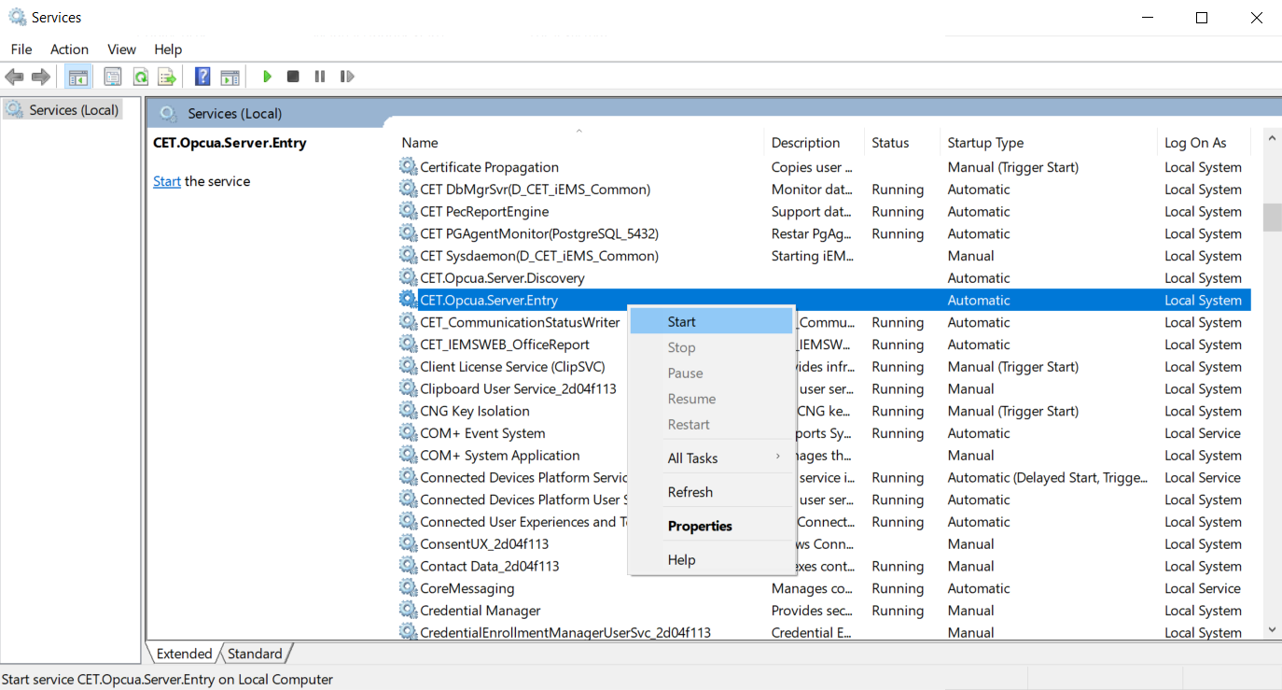
Install CET OPC UA Server
Step 8: Start the CET.Opcua.Server.Discovery and CET.Opcua.Server.Entry services.

Slide 15
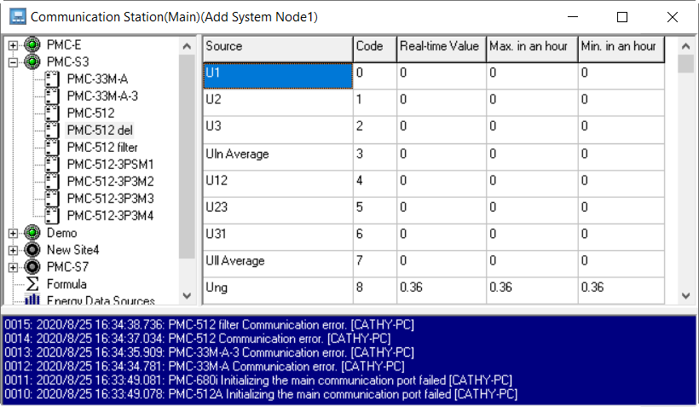
Realtime Communication
Step 9: Run PecSCADA.

Slide 16
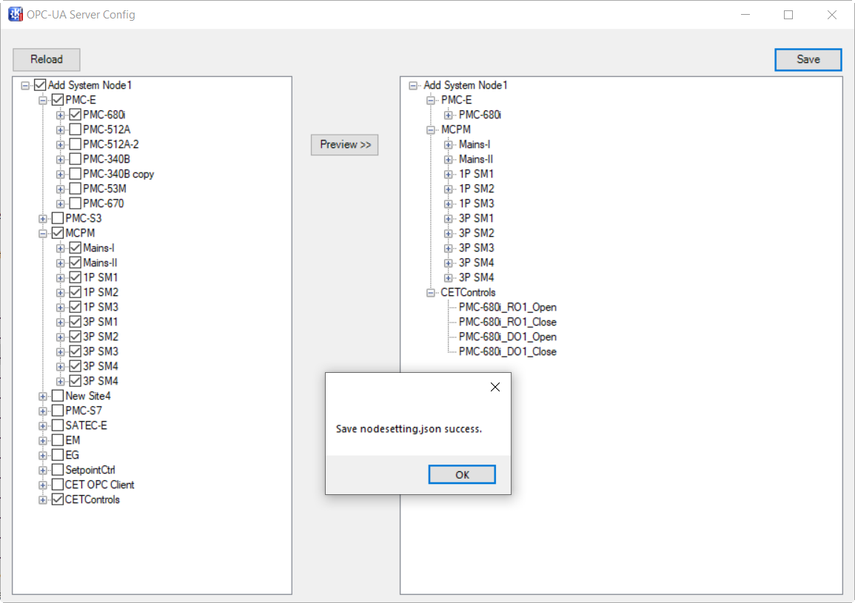
CET OPC UA Server Configuration
Step 10: Run \Opcua.Server Run On the PecStar V3.5\CET.Opcua.Server.ConfigTool.exe by Administrator. In the OPC-UA Server Config window, select the sites/devices/data points on the left pane that need to provide to the OPC UA Client and click Save. Then close the program.
Click Preview>> to show the selected nodes.
Skip this step if all nodes are needed.
Note:
1. Before run CET.Opcua.Server.ConfigTool,
stop CET.Opcua.Server.Entry service first.
2. If the configuration is changed, need to
restart CET.Opcua.Server.Entry.exe and
OPC UA Client.

Slide 17
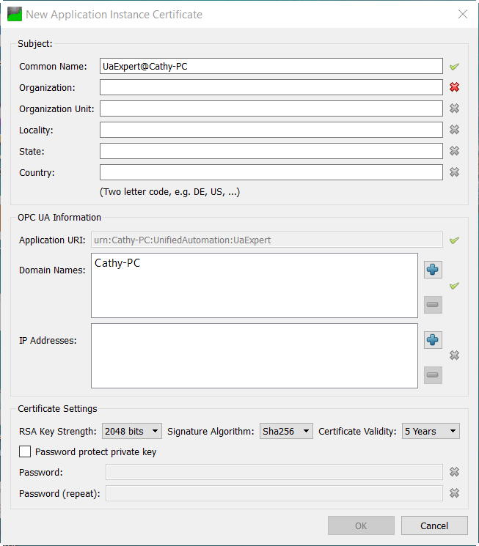
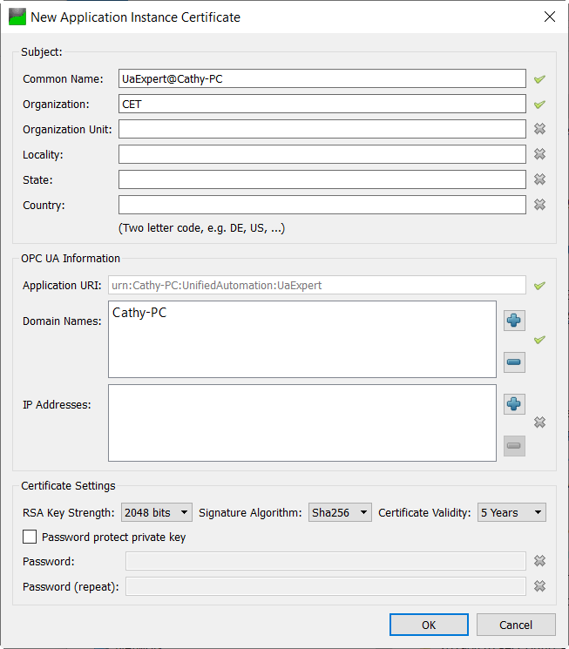

Add OPC UA Server
Step 11: Run uaexpert-bin-win32-x86-vs2008sp1-v1.5.1-331.exe to install UA Expert under the \OPC UA Server folder. Run UaExpert on the desktop by Administrator, input Organization and click OK in the Certificate window.

Slide 18
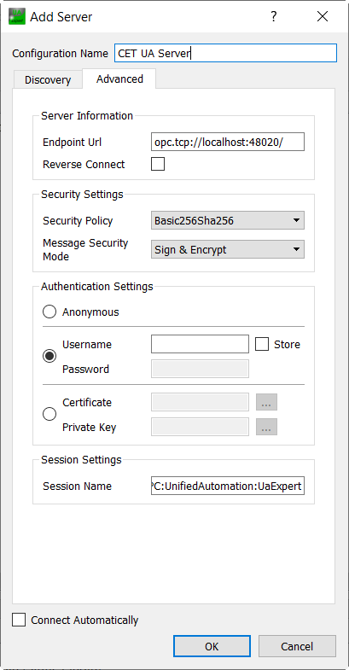
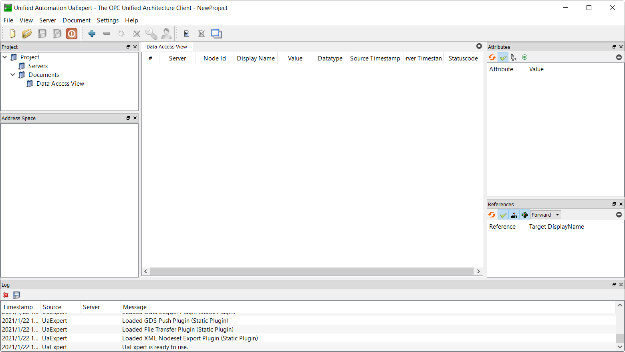
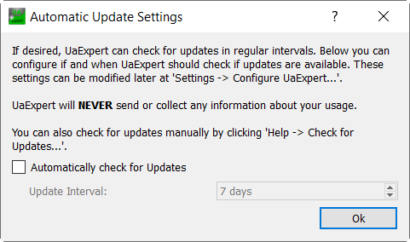
Add OPC UA Server
Uncheck Automatically check for Updates option. In the OPC UA Client main interface, click the + button, the Add Server window appears. Select Advanced tab, input Name and URL then click OK.
Configuration Name: Self-Defined
Endpoint Url: opc.tcp://localhost:48020

Slide 19
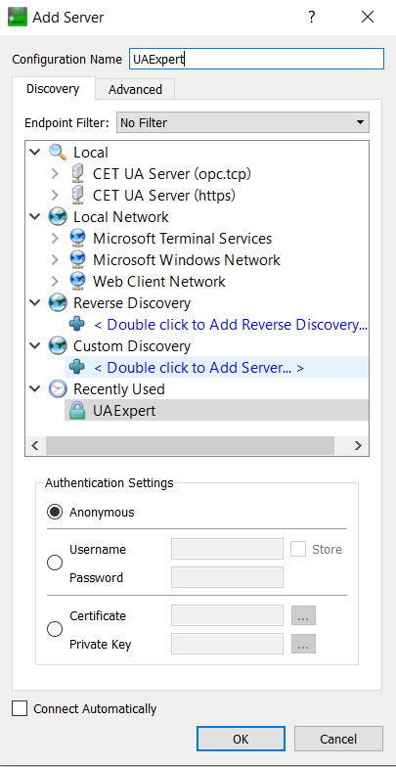
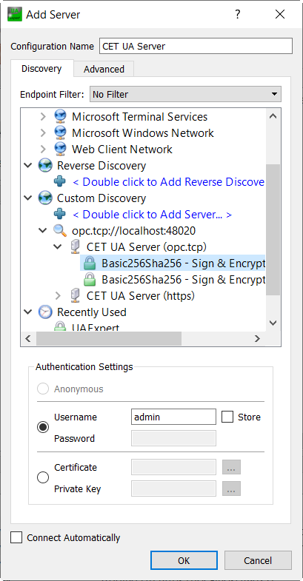
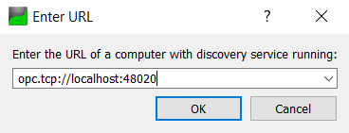
Add OPC UA Server
Or select Discovery tab, expand Custom Discovery -> Double Click to Add Server, input localhost:48020 and click OK, then expand it, select CET UA Server (opc.tcp) -> Basic256Sha256 - Sign & Encrypt (uatcp-uasc-uabinary), input Username: admin and click OK.

Slide 20

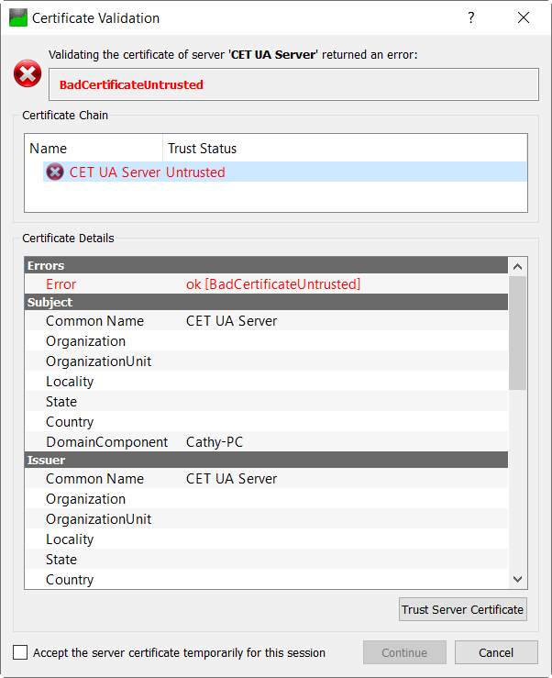
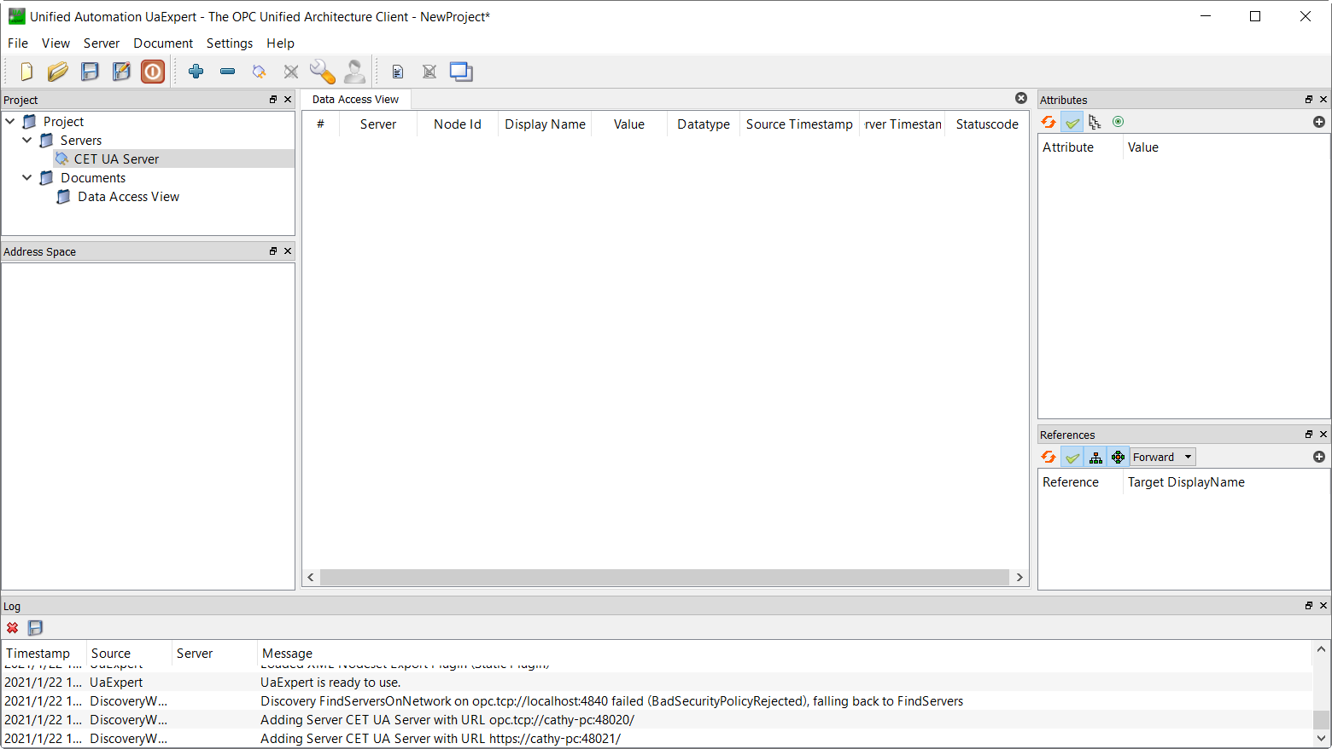
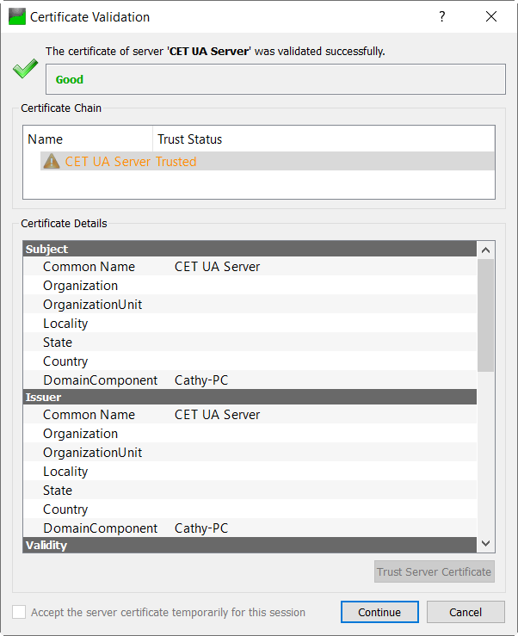
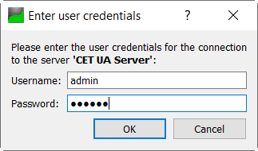
Add OPC UA Server
After the CET OPC Server is added, click the button to connect server, input Password: 123456 and click OK. In the Certification Validation window, click Trust Server Certificate button, then click Continue.

Slide 21
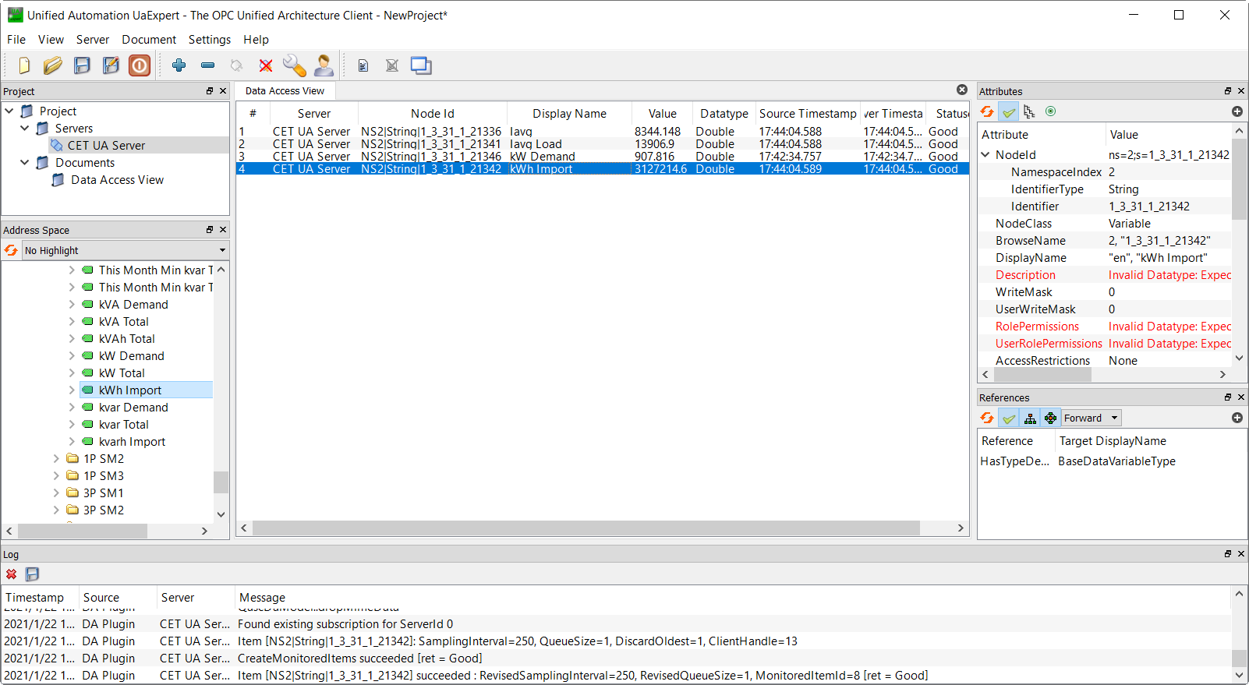
Realtime Data
Step 12: In Address Space, expand Root -> Objects -> Add System Node1, select a site and a device, all the parameters are listed under the tree. Drag a parameter to the Data Access View window to subscribe it, then the realtime value will be shown.

Slide 22
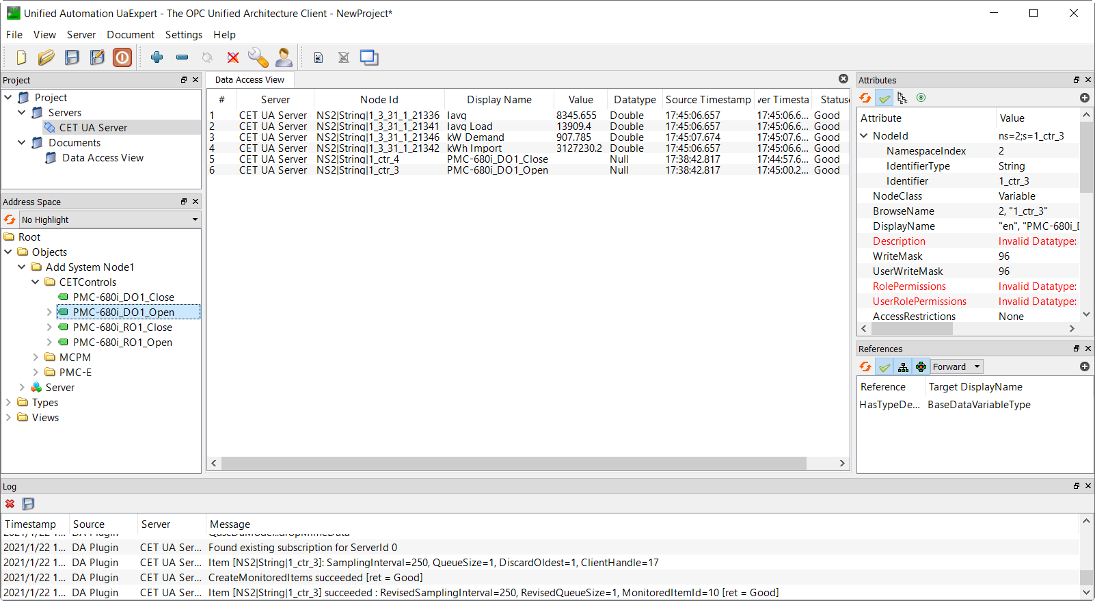
Controls
Step 13: Expand Root -> Objects -> Add System Node1 -> CETControls. Drag a control point to the Data Access View window to subscribe it. (Ua Expert does not support perform control operations.)

Slide 23
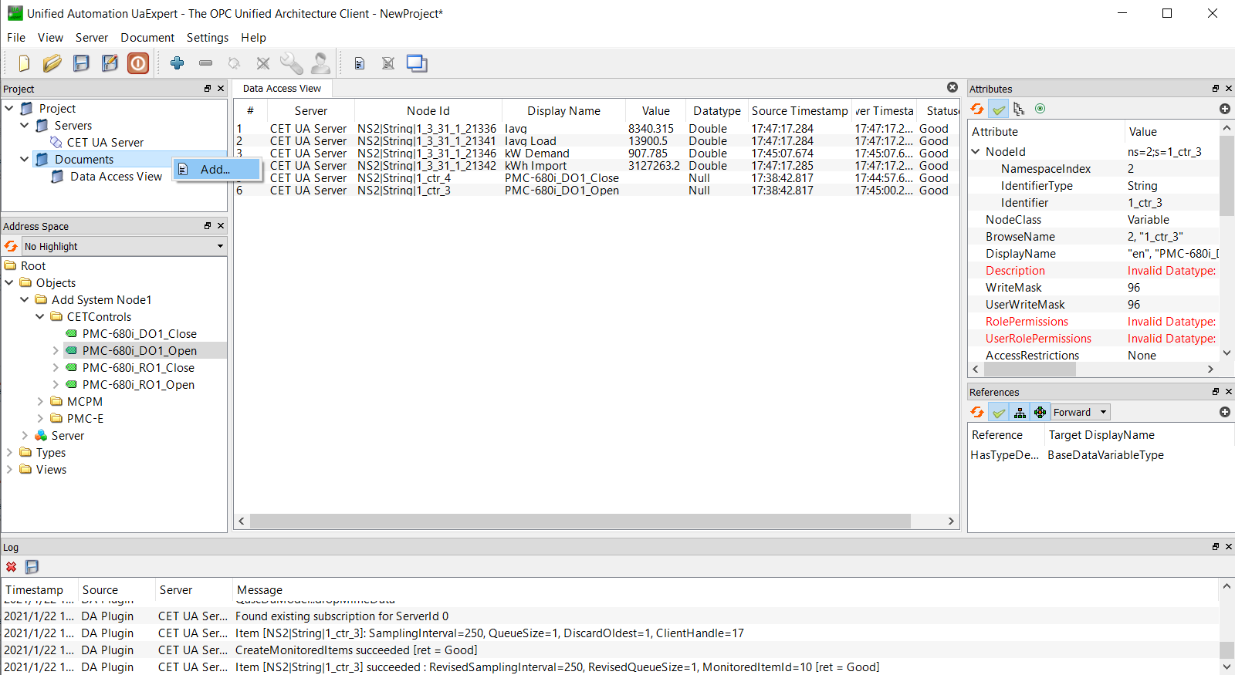
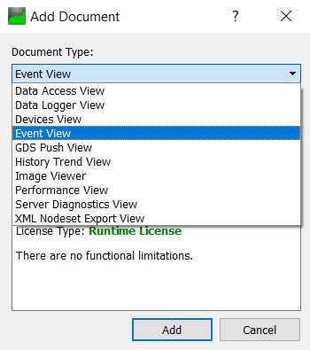
Event & Alarm
Step 14: In Project, right-click on Documents and select Add…, set Document Type to Event View and click Add.

Slide 24
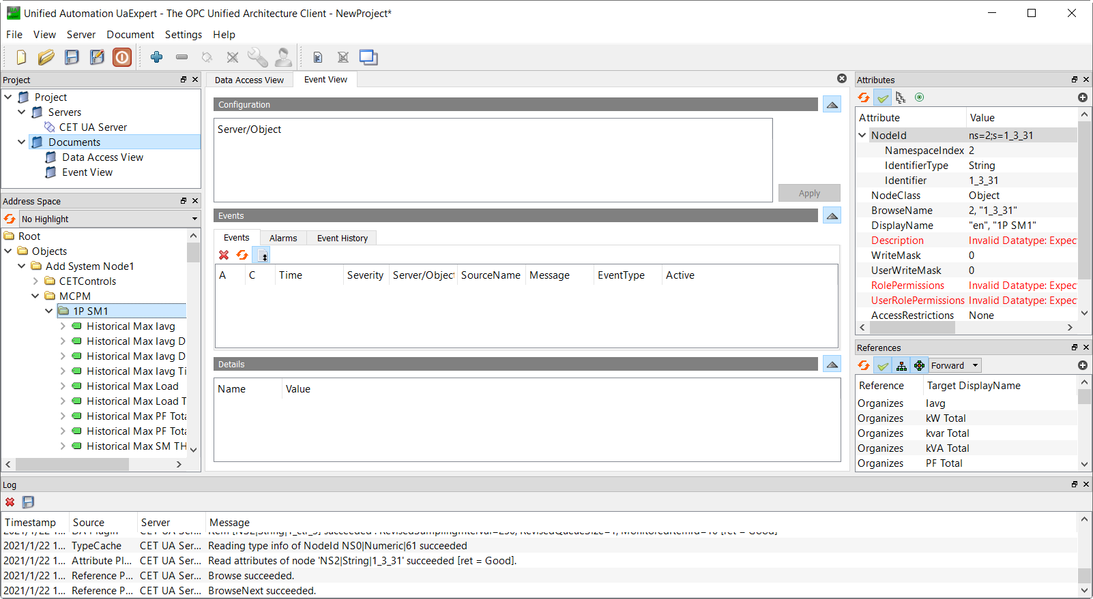
Event & Alarm
Step 15: In Address Space, expand Root -> Objects -> Add System Node1, select a device node, then write down the NodeID in the Attributes area on the right pane.

Slide 25
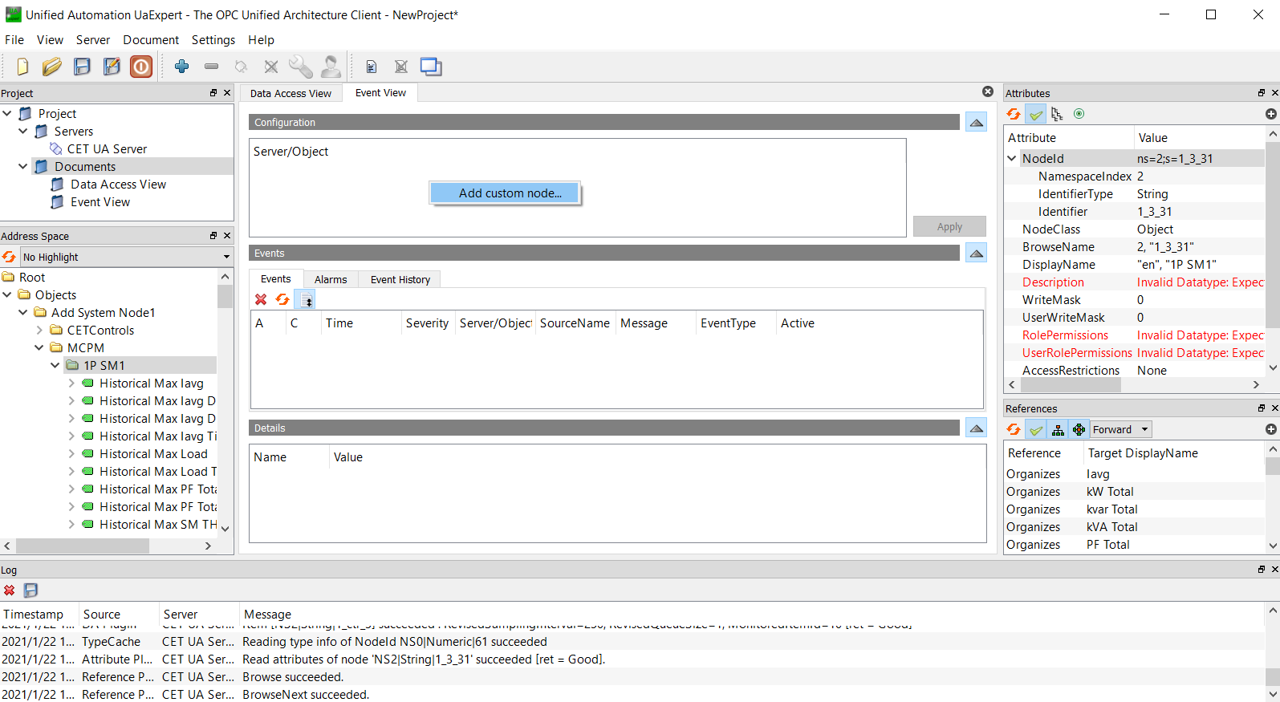
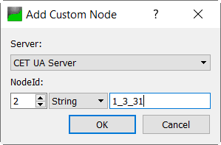
Event & Alarm
Step 16: In Event View window, right-click in the Configuration area and select Add custom node…. Input NodeID and the String as noted in Step 9.

Slide 26
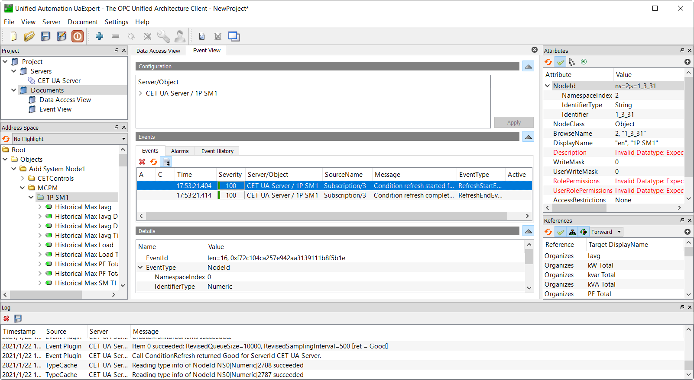
Event & Alarm
Step 17: After subscribed the device, the realtime events will be shown in the Events area.

