Slide 1

PecWhatsApp Introduction
(End User Version)
by CET IBD / 2022-01-17

Slide 2
Content
Section 1: PecWhatsApp Client Introduction and Configuration SOP
Section 2: PecWhatsApp Server Introduction

Slide 3
Section 1: PecWhatsApp Client Introduction and Configuration SOP

Slide 4
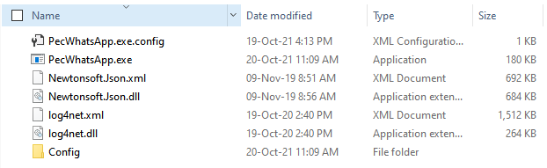
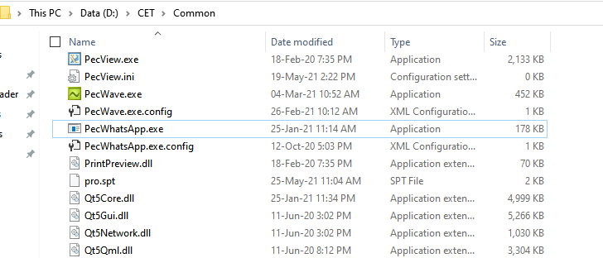
Preparation
1. Download the compressed client tool files from https://ibd.cet-global.com/p?d=fp5Nya
2. Stop all iEMS related programs including PecConfig, PecFront and Dserver, and etc., unzip the tool files and copy all of them to the Common folder of iEMS.

Slide 5
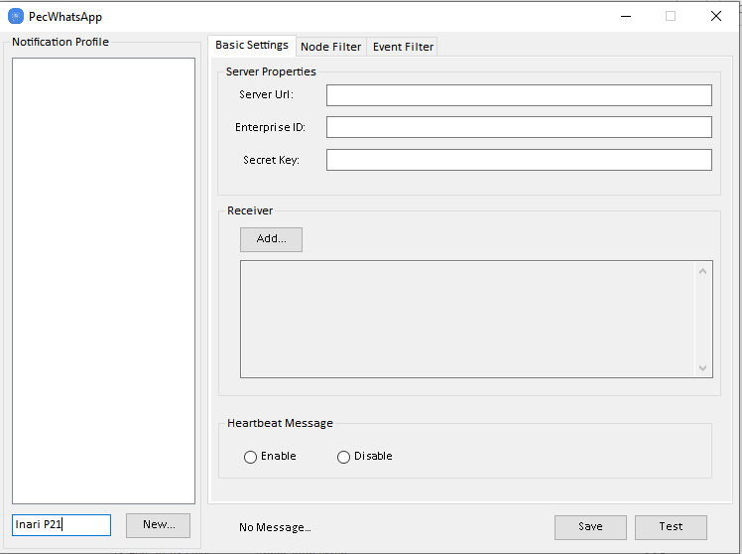
PecWhatsApp Client Configuration
1. Double click PecWhatsApp.exe to start the client module.
2. Add configuration profile
key in the profile name and click New to add.
Note: If you need to remove the profile, right click on the profile name and the Remove button will pop up, then click on Remove button to remove the profile. Please note the remove operation is not available when only one configuration profile left or when the profile configuration is not completed.

Slide 6
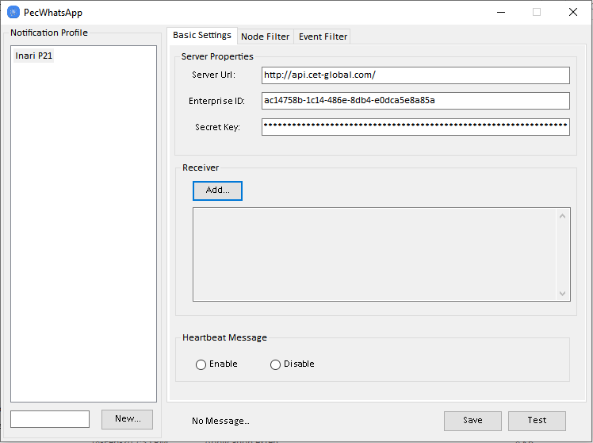
PecWhatsApp Client Configuration
3. Server properties configuration
Key in the server url: http://api.cet-global.com/
Key in Enterprise ID: Provided by CET IBD
Key in Secret Key: Provided by CET IBD
Enable the Heartbeat Message if necessary.
Click Save to save.

Slide 7
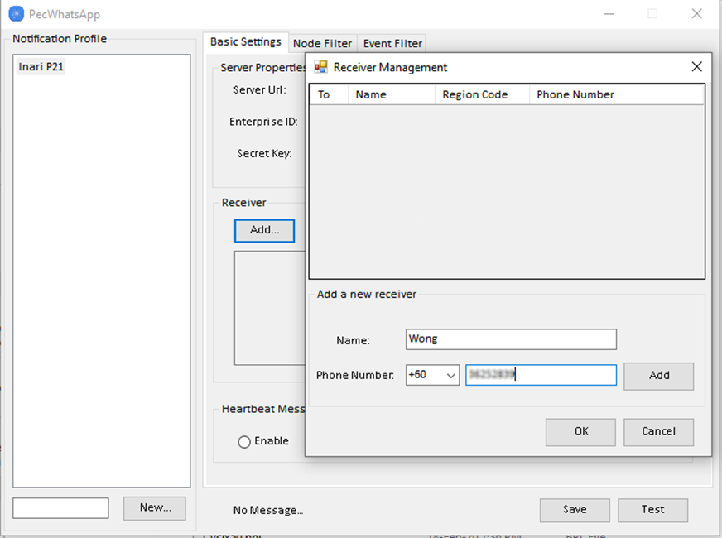
PecWhatsApp Client Configuration
4. Add receiver
Click Add... to add receiver
Select the region code, input phone number and receiver name, click Add to add the new receiver.
Note: The phone number region is controlled by PecWhatsApp Server, if you need to send the WhatsApp message to other countries out of region, please state that clearly in your PO beforehand.

Slide 8
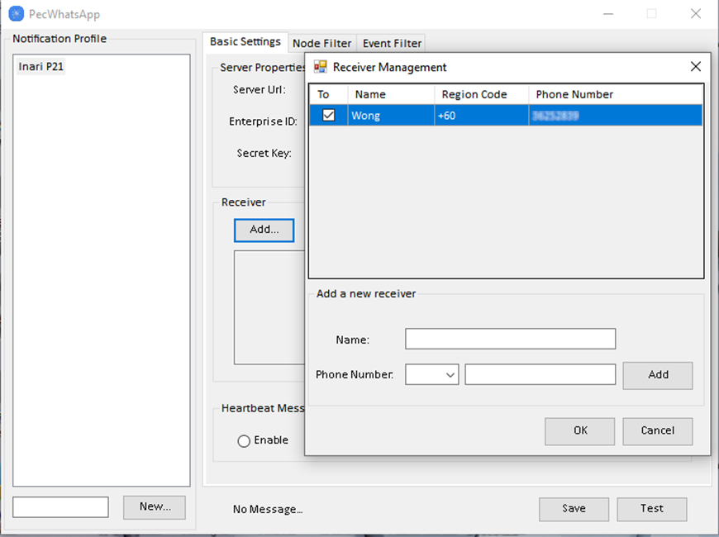
PecWhatsApp Client Configuration
5. Select Receiver
Tick the message receiver and click OK to save.
Note: If you need to remove a receiver, right click on the receiver and the Remove button will pop up, then hit the Remove button to remove it.

Slide 9
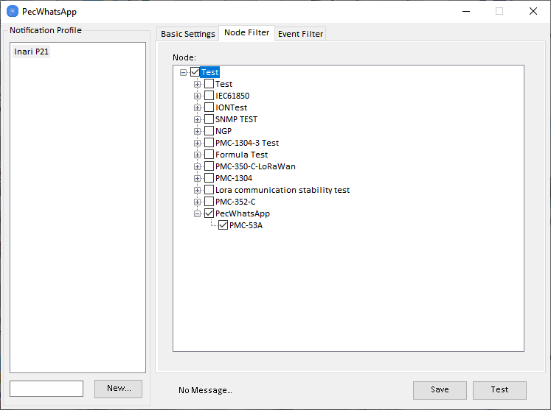
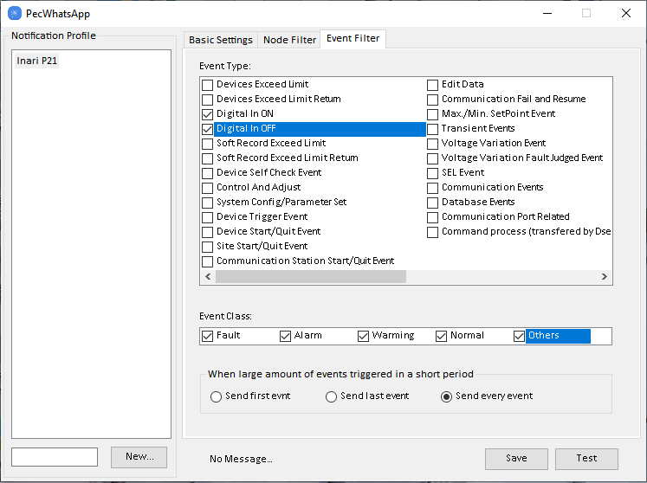
PecWhatsApp Client Configuration
6. Node filter configuration
Tick the nodes that need monitoring with PecWhatsApp, click Save to save.
7. Event filter configuration
Tick the Event type and class that need to be monitored by PecWhatsApp.
Check Send every event (Suggested).
Click Save to save.
Click Test to send test message.

Slide 10
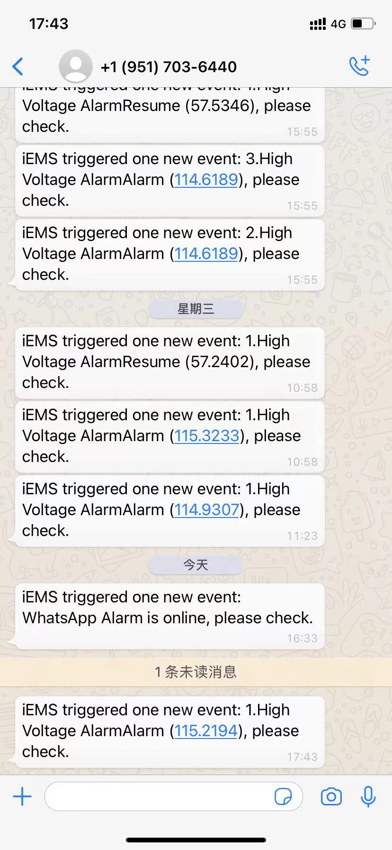
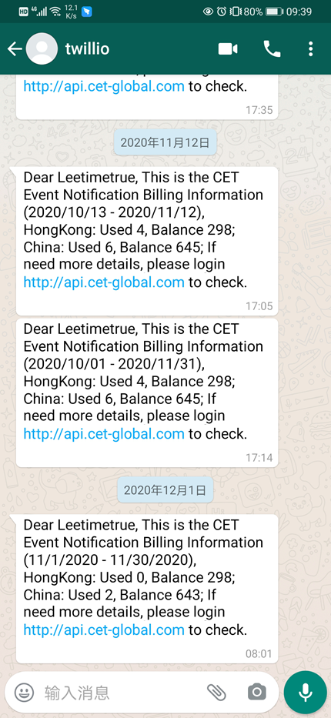
WhatsApp Message and Log
PecWhatsApp will send three types of messages:
1. Test and Heartbeat message:
iEMS triggered one new event: WhatsApp Alarm is online, please check.
2. Alarm message:
iEMS triggered one new event: + No. + Alarm Content +,please check.
3. Billing Information
If select WhatsApp method to receive billing information, PecWhatsApp Server will send the billing information every 1st.

Slide 11
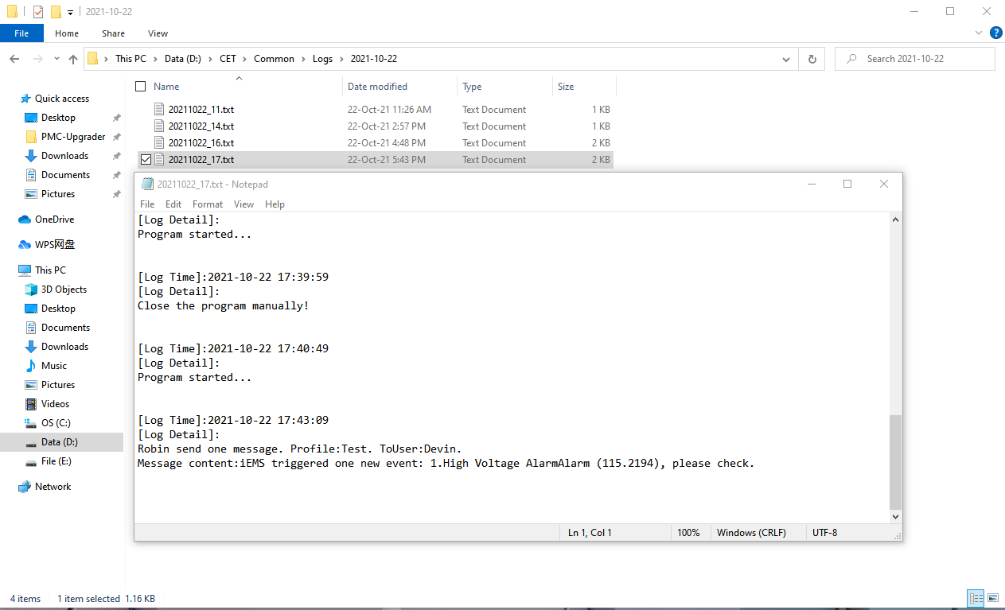
WhatsApp Message and Log
PecWhatsApp Client module’s local logs are stored under Common\\Logs\\Dates and organized by hour.

Slide 12
Section 2: PecWhatsApp Server Introduction

Slide 13
Briefing
PecWhatsApp Server (End User Version) provides following features:
1. Account overview, including account basic information, alarm statistics and balance.
2. Phone number and password change.
3. Alarm record, including receiver name, phone number and timestamp.

Slide 14
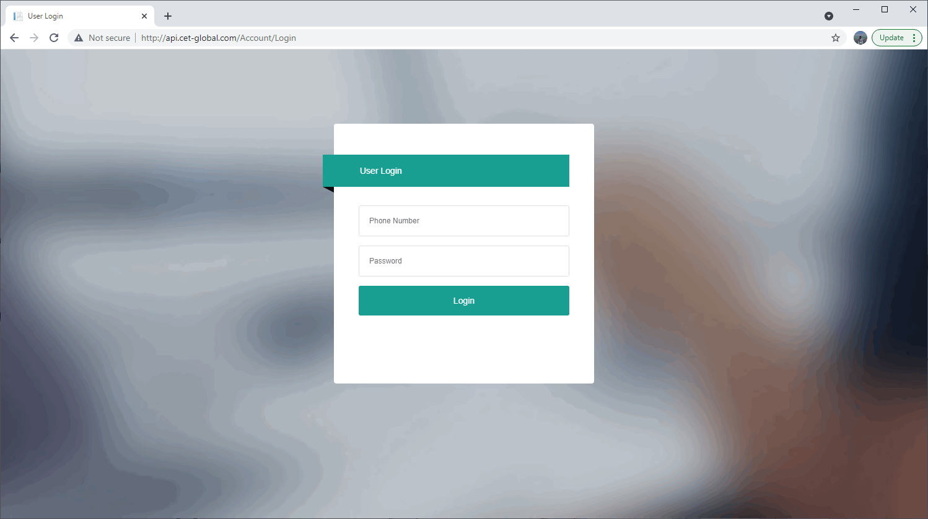
Login
1. Open web browser (Google Chrome Suggested), key in the URL address (http://api.cet-global.com) and open the login page.
2. Login with the phone number (without region code) and password (123456 by default), each project has one phone number registered in system to login PecWhatsApp, please contact with CET IBD if you have any problem with the account login.

Slide 15
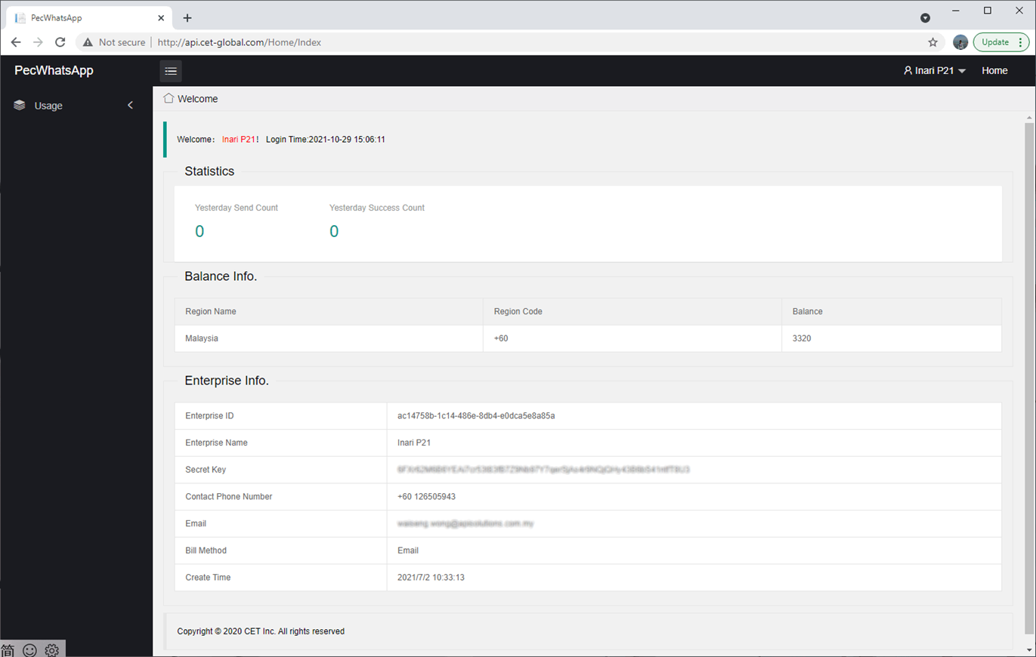
Account Overview
Statistics:
Alarms quantity sent yesterday, including total and success number, some alarms may have failed to reach the receiver due to the service error or connection issue with WhatsApp server.
Balance Info.
Balance information by country region, as left picture, the project still can send 3320 alarms to Malaysia receivers.
Enterprise Info.
Including Enterprise ID, Name, Secret Key, Contact Phone Number, Email, Bill Method and Created Time.
Note: The bill method is preset by CET IBD, supports email or WhatsApp.

Slide 16
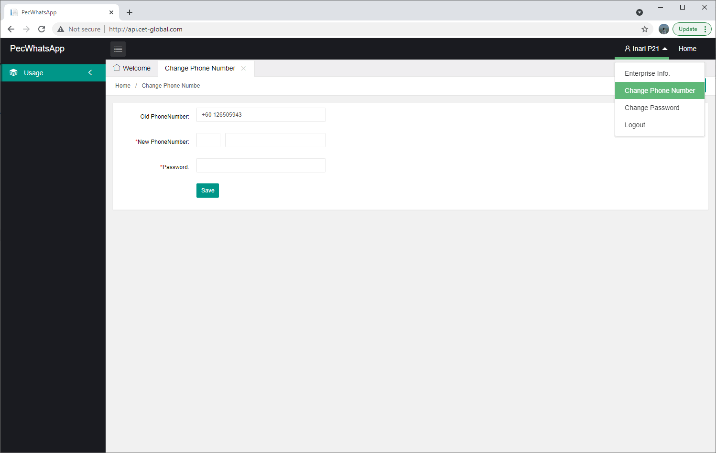
Change Phone Number
Move mouse to the account icon, and click Change Phone Number, then key in the new phone number (with region code) and current password to change the registered phone number.

Slide 17
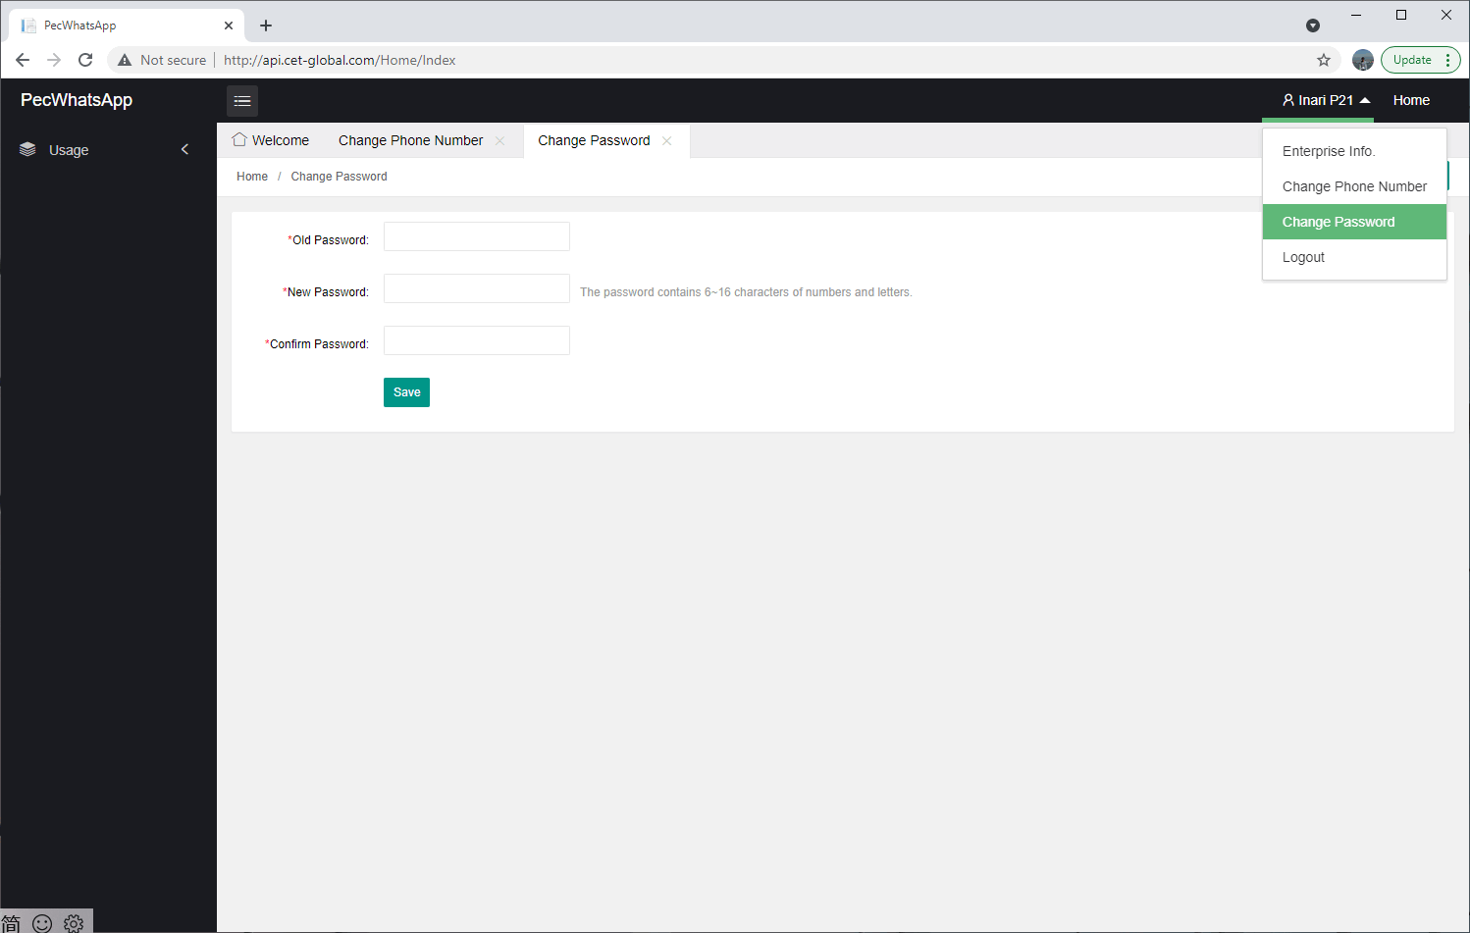
Change Password
Move mouse to the account icon, and click Change Password, then key in the old password and new password to change the login password.

Slide 18
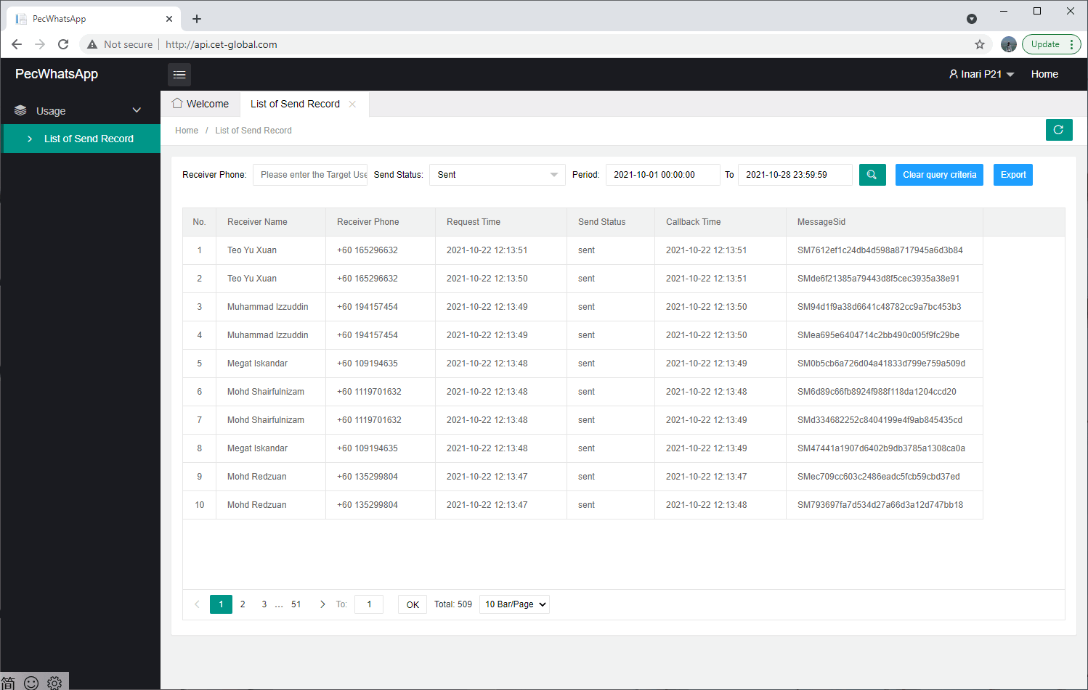
Alarm Record
Select the period to query the alarm sending record, also supports filter by receiver phone number (without region code).
Due to memory and encoding issues, PecWhatsApp doesn’t provide raw alarm record, you can find the raw alarm record on client PC where PecWhatsApp is running, the alarm record on PecWhatsApp is designed for troubleshooting and verification.

